Slide 1
Computer Vision for Advanced Circuit Fabrication
Isaac Rodriguez (Sonoma State University)
Connor Emery (Bryant University)
Case Kirk (Ozark Integrated Circuits)
Walt Niblock (Ozark Integrated Circuits)
National AI Campus
Spring 2023 Showcase

Slide 2
Team Members
Coach Team:
Case Kirk (Ozark Integrated Circuits)
Walt Niblock (Ozark Integrated Circuits)
Jennifer Fowler (Arkansas State University, AR NSF EPSCoR)
Drew Fleming (Arkansas State University)
Participants:
Isaac Rodriguez (Sonoma State University, CA)
Connor Emery (Bryant University, RI)
Darrell Hood (University of Arkansas at Pine Bluff)
Wesley Heikes (Arkansas Tech University)
James Chen (New York University)

Slide 3
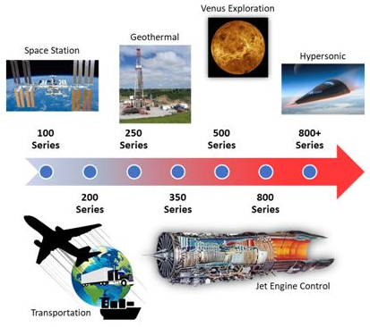
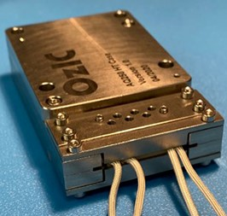
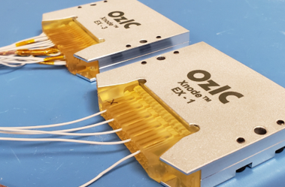
Ozark Integrated Circuits (OzIC)
Notes:
*add/change pictures
Explain background of ozark integrated circuits and why they need the project?
Ozark Integrated Circuits is a Extreme Environment Company
Business is in EXTREME environments on various ends of the spectrum
Freezing point of gasoline to melting point of aluminum
Specialize in the design of analog and mixed-signal integrated circuits
Design processes get intense and complex
Various materials have different properties at different temperatures - this influences the overall design.
speaker : case

Slide 4
Project Background & Data Source
Quality control is manually performed, with someone carefully examining scanned images of each layer of the substrate ensuring each punch went through cleanly with no blockages.
OzIC already uses Python in a variety of processes and was interested in exploring automation.
Dataset included scanned images of layers used in production modules (design templates, actual punched substrate, and some failed layer examples).
Actual images are subject to export control, and all team members signed non-disclosure agreements and worked with the data securely.
Design File
Fabricated Layer
Defect - incomplete punch
Notes:
While quality control can be done manually (and has been for a while), we’d rather not drive anyone to insanity by counting thousands of holes in one fabricated design.
OzIC already utilizes Python for a number of processes that enable rapid innovation, so we decided to try and see if a viable solution included machine learning through the Python language. When we realized just how involved it would be, we started unraveling a design project that (while exciting) would take us a bit to develop. This is ultimately what led OzIC to work with Nat. AI Campus.
We had data from our design and fabrication processes, an interesting problem, and an application that would help the semiconductor industry in a time where the nation is gearing up for rapid semiconductor manufacturing. By providing design files and scanned images of fabricated boards, our goal was to enable a group of students to aid in the development of a tool that would assist us in our endeavour to rapidly produce products reliably - bonus points if the team could open source the tool to enable other startup companies like us to be able to perform real-time, rapid verification checks.
speaker : walt

Slide 5
Project Challenges
Initial project challenges:
Comparing punches on the design template to the actual fabricated layer making sure the quantity of punches match.
Examining each punch (thousands per layer) to make sure the punch was complete and clean.
Creating data for a convolutional neural network by segmenting isolated pictures of vias into separate images.
Making sure that all defects were caught in the detection phase
Notes:
Identify punches exist
Ensure punch quality is 100%
Segment punches to create dataset
connor

Slide 6

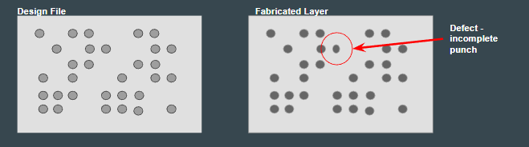
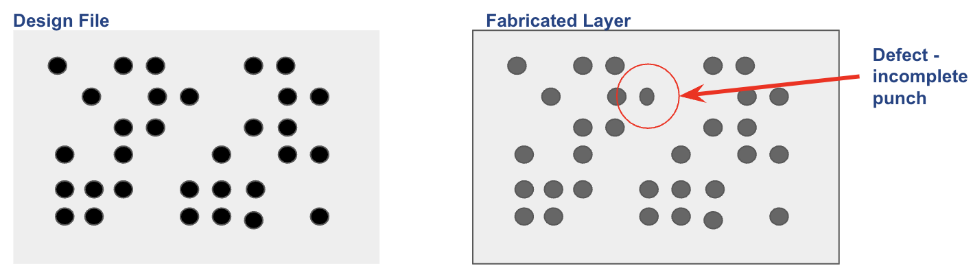
Problem Statement
Yield verification of manufactured products in real-time through the use of python and machine learning.
Notes:
Speaker: Isaac
Our ultimate goal is to create a system that can reliably classify defects in real-time using python.
Understanding our challenges was our first priority. We first decided to research machine learning and AI in a manufacturing setting. We did this to figure out what techniques or algorithms were being used in manufacturing today. From there we experimented with different ways to capture the punches. Ultimately we found out that preprocessing was key for extracting clean and usable features.
As you will see in later slides, we came up with three features that established a solid foundation for new teams to come.
Image souce:
https://opencv.org/opencv-python-is-now-an-official-opencv-project/

Slide 7
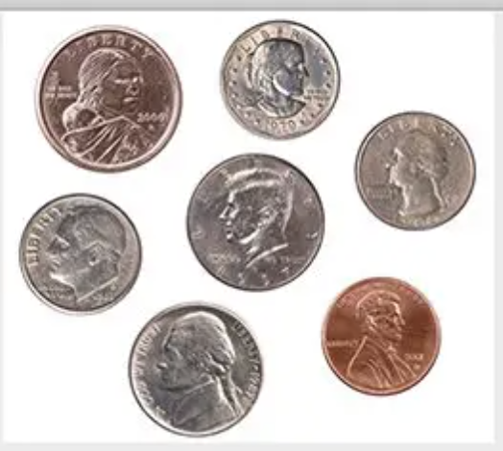
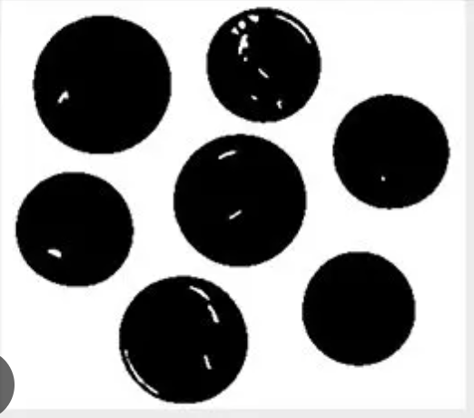
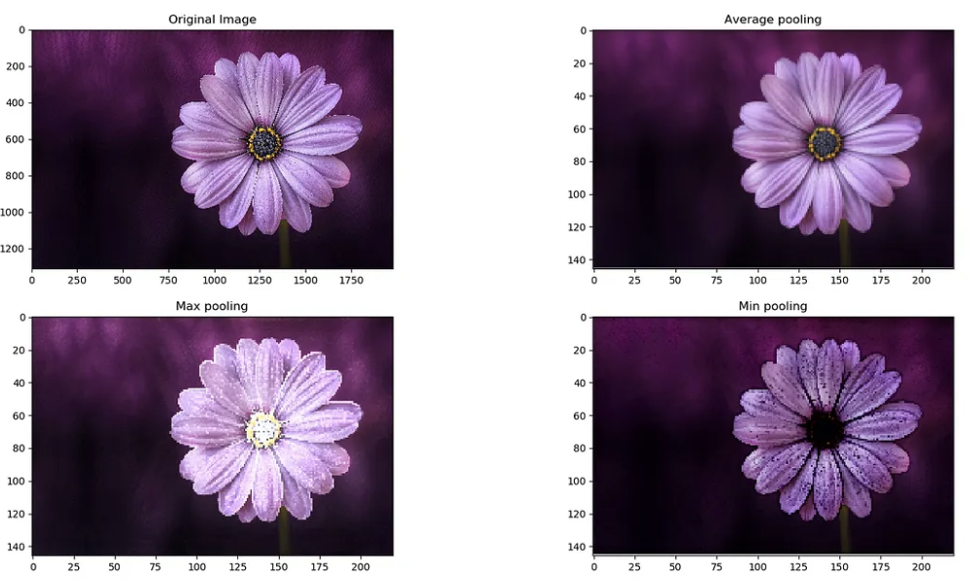


Punch Counter
Binary
Thresholding
Counts all punches excluding defects
Fabricated Layer
Defect - incomplete punch
Minimum
Pooling
Erosion
Filter
Notes:
Speaker: Isaac
Initially as a team, we went our separate ways to understand the different ways we can accomplish this task. Doing so, we were able to expose a variety of different methods, ideal or not. One method might be best used for via inspection while another might be useful for trace short/open inspection. As we started with just inspecting the punched vias, open cv became the primary python library to utilize. Using the detect contours function was perfect for finding circular objects in the scanned image.
In order to get the best results with opencv, pre processing became a must. Effort was put into the preprocessing operations like cropping, image filtering, and alignment. These preprocessing steps are important to fine tune and will become a big factor in the results.
And so,
The techniques I used in preprocessing were binary thresholding, minimum pooling, and an erosion filter. Binary thresholding removes the background or it can color in pixel values that are different from the background. Using this technique we can only extract the punches. From here we use minimum pooling to make punches more prominent and reduces the size of the image by half. Finally the erosion filter greatly emphasizes the punches.
From here openCV can find the area of each punch. If the punch is within a certain area then it will be counted as a punch.
This happens to be my first time using OpenCV, and after struggling with it. I feel confident i can apply OpenCV to any image processing challenges i may have.
After preprocessing, detecting the punches reliably became much easier - which is important for the accuracy of the punch counter. This then fed into a series of debates and avenues on how it was best to section the scanned layer.
Did you have experience with these before, or was it something new you learned?
Student reply^^^^
Image source:
https://pyimagesearch.com/2021/04/28/opencv-thresholding-cv2-threshold/
https://medium.com/@bdhuma/which-pooling-method-is-better-maxpooling-vs-minpooling-vs-average-pooling-95fb03f45a9
https://www.geeksforgeeks.org/erosion-dilation-images-using-opencv-python/

Slide 8
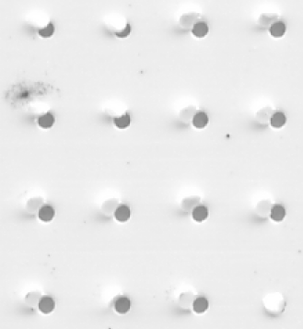
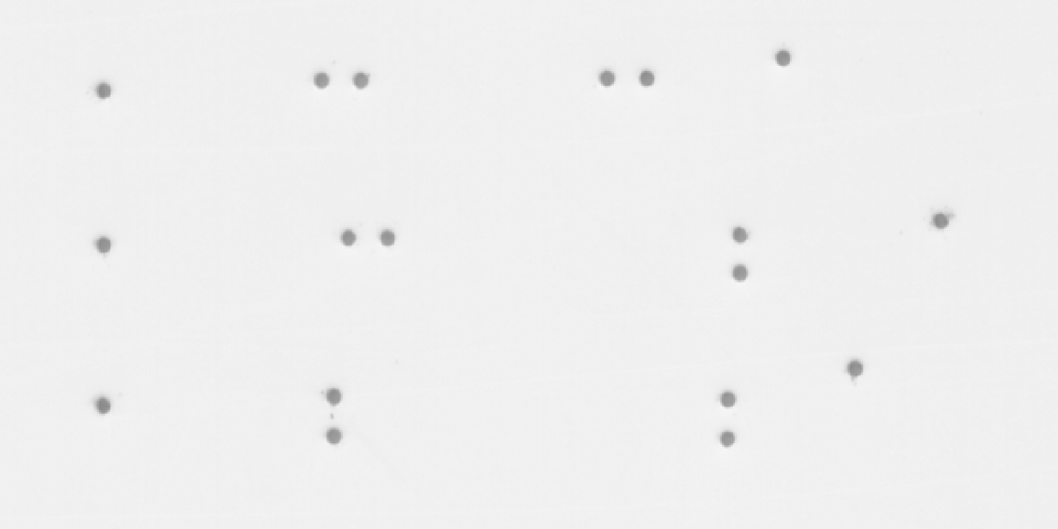
Visualizations
Defects: Clean Punches:
Notes:
Isaac

Slide 9

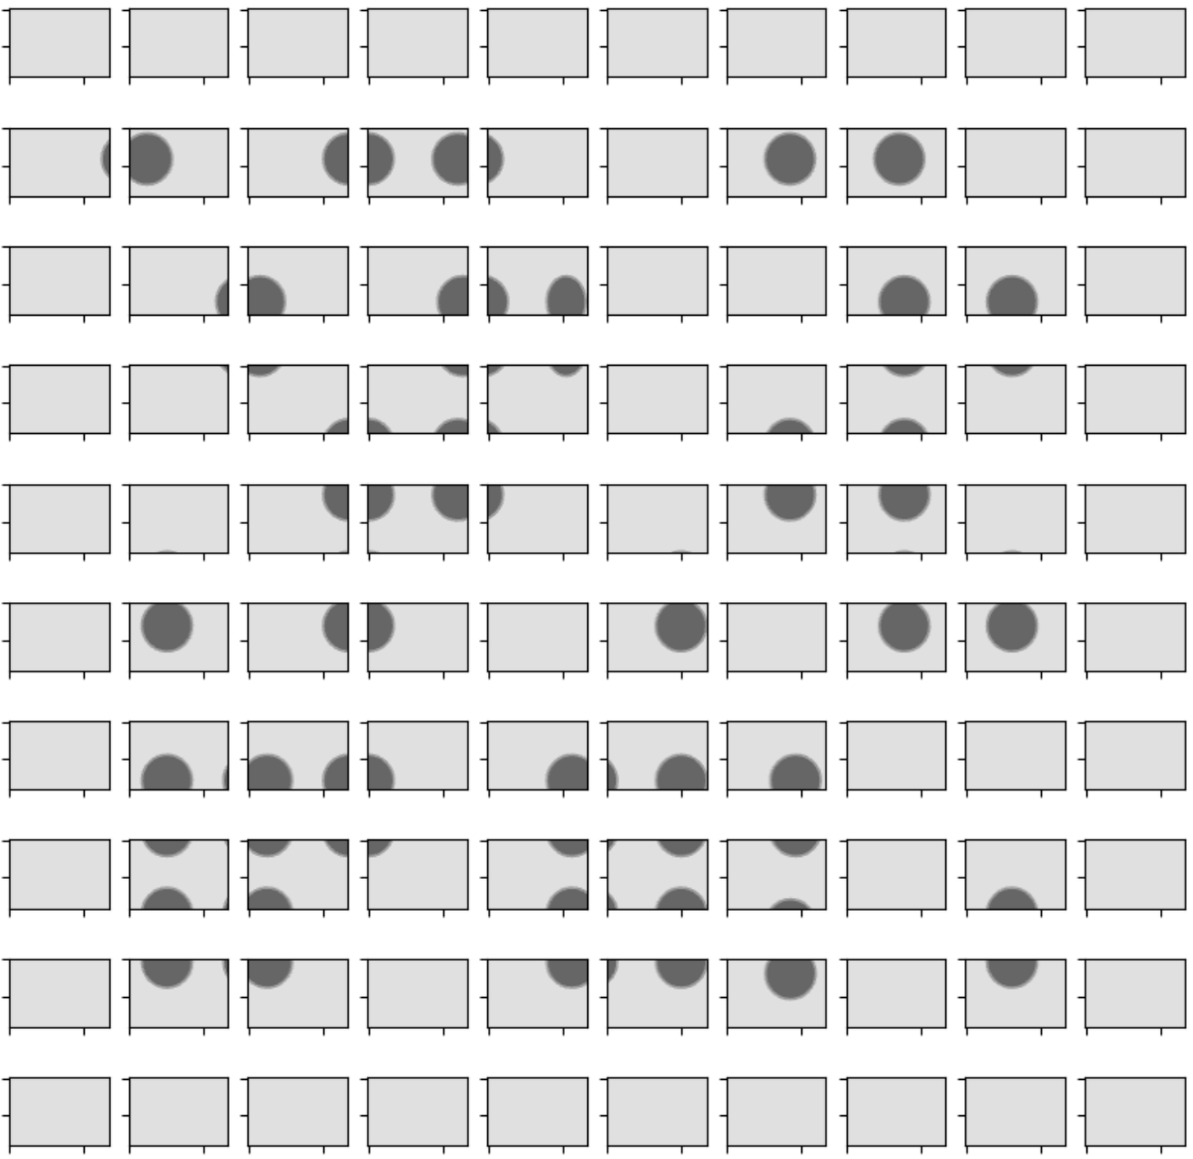


Object Detection
Original Image
Trying to capture vias
Notes:
Image segmentation process: connor
First, we explored segmenting the image into uniform grid of smaller images - the problem with this would be the specific pattern is unique to the design used. OzIC prefers a completely adaptable program to assist manufacturing as we constantly change and update designs where we are in our rapid development and prototyping. ** mention that segmenting did not properly capture all vias**
To supply data for the convolutional neural network, we first needed a lot of data; secondly need someone to check the data. As a milestone, even having the individual punches segmented and displayed in a grid (eliminating the pattern) would be dramatically better than scrolling through the vias across an entire scanned image. The ideal case is to display a 10x10 - 50x50 grid of vias adjacent to one another - that can then be marked if bad → marked vias then get identified on a separate image to show you the location of said defect and secondly train the model.

Slide 10
Image segmentation
Created a python script in order to take the original image, convert that image to grayscale and find contours using cv2 library
These new images were then wrote to a new file so they could be analyzed further in a defect turker
Challenges
Due to the nature of the images, many times images would come out grainy and it was hard to tell exactly where the borders were. By creating the initial threshold and backing off of it slightly, this should be able to fix this issue for the future
Notes:
Connor

Slide 11
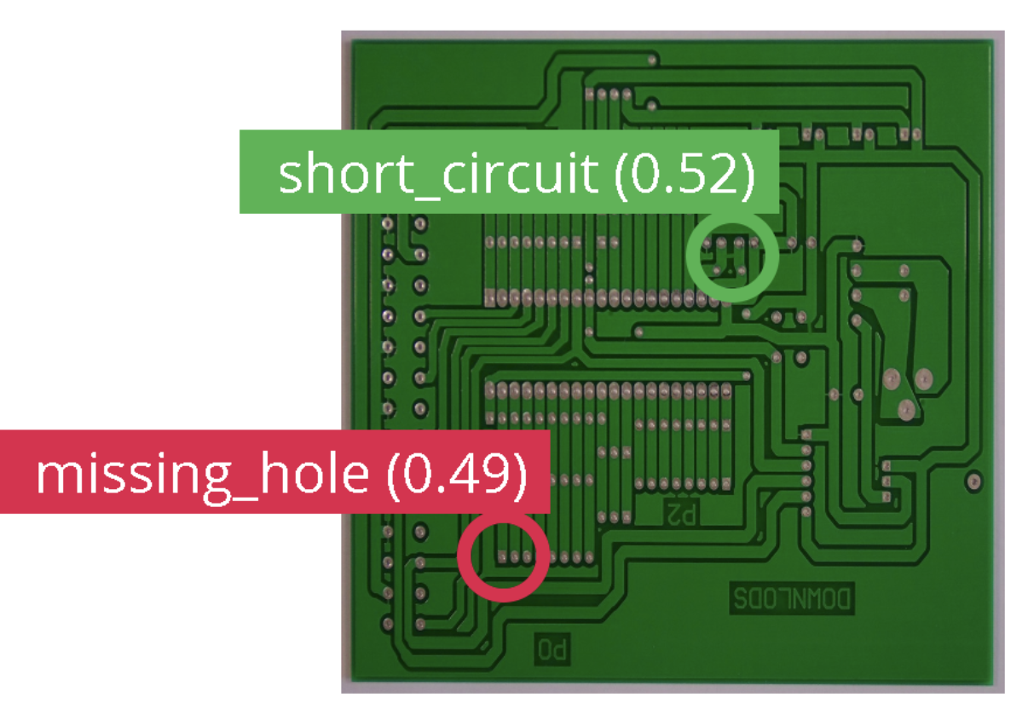
Anomaly Detection & Analysis
Highlights areas that may be defective
Fabricated Layer
Notes:
Speaker: Isaac
In order to detect anomalies, we needed everything on the image to be more prominent. Earlier i introduced binary thresholding, but that happens to be destructive and only highlights certain features. In this case, I used something called adaptive thresholding. This means that different regions on the image will have different thresholding values. This allows us to extract all the artifacts or objects on the image.
Now using OpenCV, we were able to find the area of all the stuff in the image. From here exclude anything that has the area of a punch.
Finally I calculate the center of the anomaly and draw a bounding circle around it.
This works fine right now as a starting point or proof of concept, but we are really trying to get to a more elegant solution such as the image on the right. Were we can detect multiple different types of defects. For future work.
Using these images, we can then begin to do a variety of different analysis. Primarily determining if there are blockages in the punched vias for this step. Connor/Issac any sort of analysis that you performed to achieve the results you got.
Due to the nature of the imaging, this was a major hurdle in the process as each defect of the image could be due to a missed punch, natural smudging or something else
Image source
https://docs.edgeimpulse.com/experts/prototype-and-concept-projects/identifying-pcb-defects

Slide 12
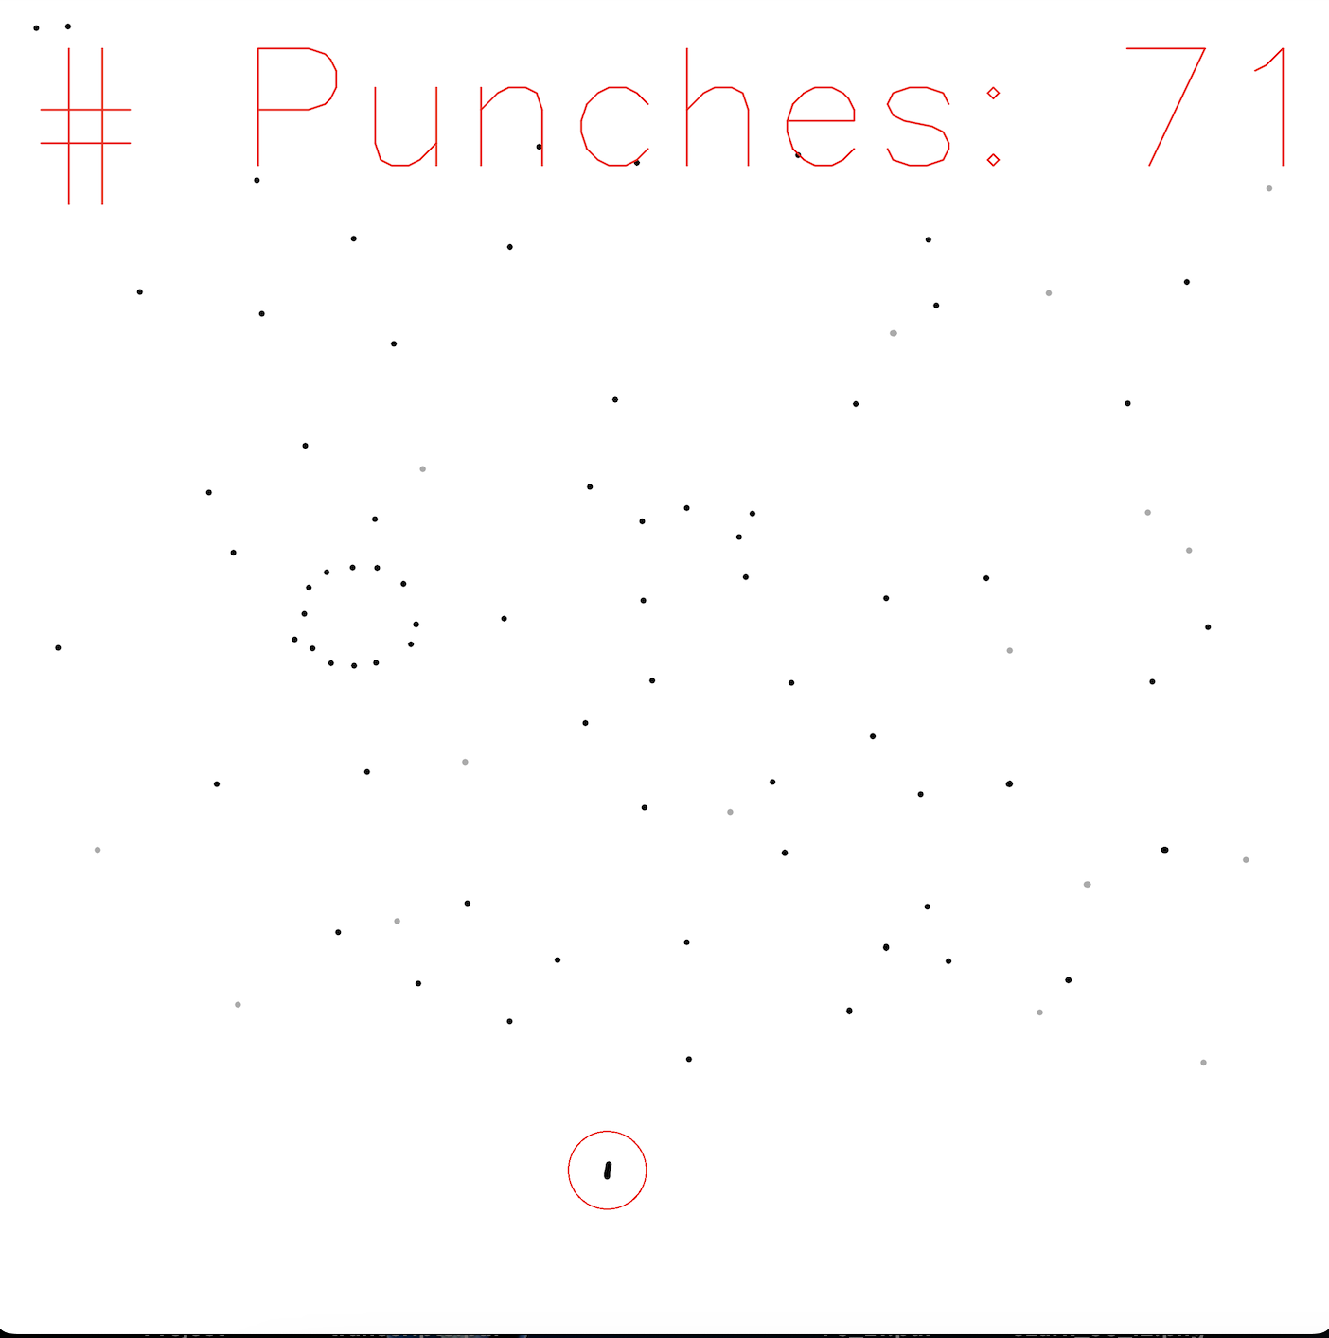
Results
We were able to preprocess and correctly analyze many of the boards
Ultimately unable to train a model yet to detect whether or not there was a defect in a given image
Accomplished all the base work for a future model
Notes:
Ultimate results show that we were unable to actually train a/the model.
What we accomplished was all the leg work that will enable a model to be trained.
Something we found was the
connor

Slide 13
Suggestions for Future Work
Expand program functionality to inspect printed via-fill and trace yield.
Via-Fill inspection will use the same image segmentation as the punched files with different preprocessing and analysis steps to highlight issues.
In order to create a working algorithm, we first have to create an application that can take in the images as input and allow someone to mark what kind of defect they are
This is the first step in taking our preprocessing work and making into a machine learning algorithm
Notes:
Walt
This project has had a great start and baseline to expand on the functionality.
Creation of classification dataset for small images of punches
Implementation of a sophisticated way to scan circuit boards in a manufacturing setting without human intervention.
Multiple defect detection.

Slide 14
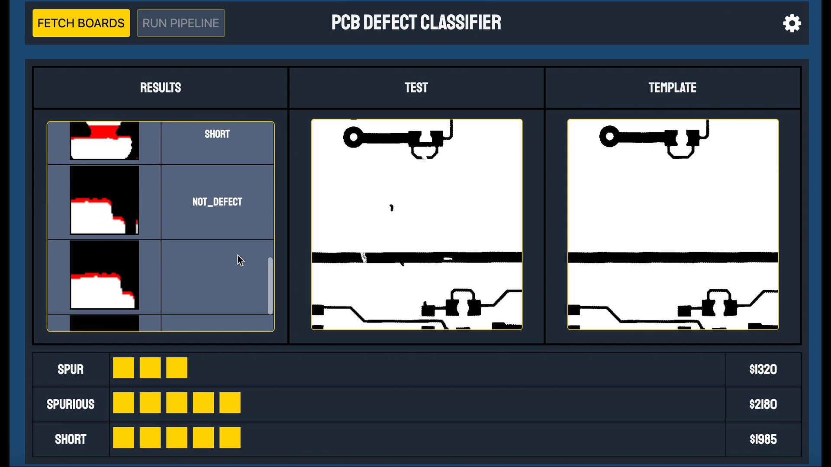

Slide 15








Acknowledgements
Thank you to the National AI campus spring cohort team and leadership for a great semester and to the OzIC team for the constant information and mentorship that they provided throughout the semester!

Slide 16
References
Vimeo defect turker image:
https://vimeo.com/388296477?embedded=true&source=video_title&owner=104920680
https://opencv.org/opencv-python-is-now-an-official-opencv-project/
https://pyimagesearch.com/2021/04/28/opencv-thresholding-cv2-threshold/
https://medium.com/@bdhuma/which-pooling-method-is-better-maxpooling-vs-minpooling-vs-average-pooling-95fb03f45a9
https://www.geeksforgeeks.org/erosion-dilation-images-using-opencv-python/
https://docs.edgeimpulse.com/experts/prototype-and-concept-projects/identifying-pcb-defects

